Slide 1
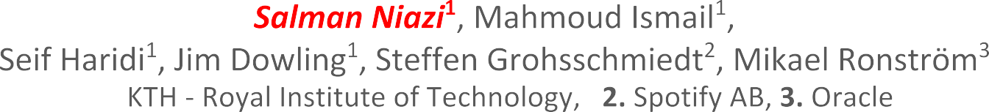





Slide 2









Slide 3


Slide 4
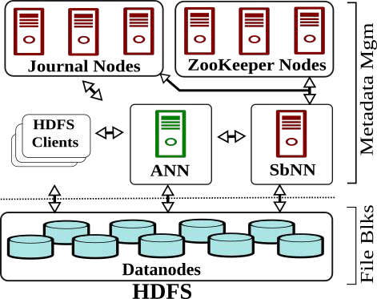

Slide 5


Slide 6


Slide 10
10

Slide 11


●
○
●
○

Slide 12


Slide 13


●
○
○
●

Slide 14
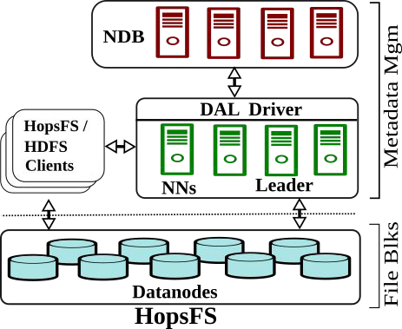
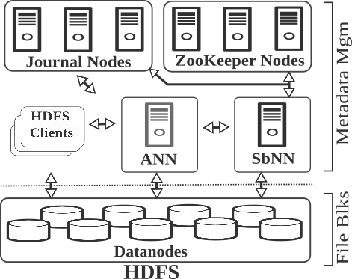

Slide 15


Slide 19


Slide 20




●
○
■
●
○
○
○
20

Slide 21


Slide 22
/
user
F1
F2
F3

Slide 23
/
user
F1 F2 F3
Inode ID
Parent INode ID
Name
Size
Access Attributes
➢ ...

Slide 24
/
user
F1 F2 F3
File INode to Blocks Mapping
Block Size
➢ ...

Slide 25
/
user
F1 F2 F3
Location of blocks on Datanodes
➢ ...

Slide 26
/
user
F1 F2 F3

Slide 27
/
user
F1 F2 F3

Slide 28
/
user
F1 F2 F3

Slide 29
/
user
F1 F2 F3

Slide 30
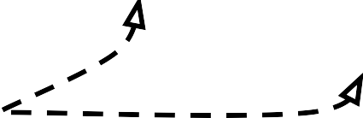
user
/
F1 F2 F3
All the tables except the INode table are partitioned by the Inode_ID
30

Slide 31
user
/
F1 F2 F3
The INode table is partitioned using the Parent_ID of an INode

Slide 32
/
user
F1 F2 F3

Slide 33
/
user
F1 F2 F3
 | / | 0

Slide 34
/
user
F1 F2 F3
 | / | 0
/

Slide 35
/
user
F1 F2 F3
 | / | 0
2 | user | 1
/

Slide 36
/
user
F1 F2 F3
 | / | 0
2 | user | 1
/
user

Slide 37

/
user
F1 F2 F3
 | / | 0
2 | user | 1
3 | F1 | 2
4 | F2 | 2
5 | F3 | 2
/
user

Slide 38
/
user
F1 F2 F3
 | / | 0
2 | user | 1
3 | F1 | 2
4 | F2 | 2
5 | F3 | 2
/
user
F1
F2 F3

Slide 39
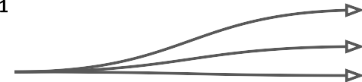
/
user
F1 F2 F3
 | / | 0
2 | user | 1
3 | F1 | 2
4 | F2 | 2
5 | F3 | 2
3 | 1
3 | 2
3 | 3
/
user
F1
F2 F3

Slide 40
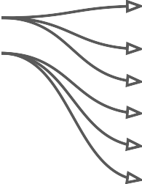
/
user
F1 F2 F3
 | / | 0
2 | user | 1
3 | F1 | 2
4 | F2 | 2
5 | F3 | 2
3 | 1
3 | 2
3 | 3
3 | 1 | 1
3 | 1 | 2
3 | 1 | 3
3 | 2 | 4
3 | 2 | 5
3 | ... | ...
/
user
F1
F2 F3
40

Slide 41
/
user
F1 F2 F3
 | / | 0
2 | user | 1
3 | F1 | 2
4 | F2 | 2
5 | F3 | 2
3 | 1
3 | 2
3 | 3
3 | 1 | 1
3 | 1 | 2
3 | 1 | 3
3 | 2 | 4
3 | 2 | 5
3 | ... | ...
/
user
F1
F2 F3
41

Slide 42

/
user
F1 F2 F3
 | / | 0
2 | user | 1
3 | F1 | 2
4 | F2 | 2
5 | F3 | 2
3 | 1
3 | 2
3 | 3
3 | 1 | 1
3 | 1 | 2
3 | 1 | 3
3 | 2 | 4
3 | 2 | 5
3 | ... | ...
/
user
F1
F2 F3
[{3,1},{3,2},{3,3}
],[{3,1,1},{3,1,2},
{3,1,3},{3,2,4}
…{3,3,9}]

Slide 43
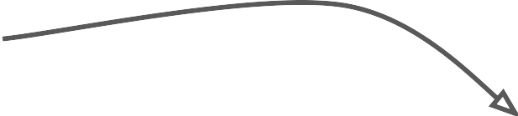
user
/
 | / | 0
2 | user | 1
3 | F1 | 2
4 | F2 | 2
5 | F3 | 2
3 | 1
3 | 2
3 | 3
3 | 1 | 1
3 | 1 | 2
3 | 1 | 3
3 | 2 | 4
3 | 2 | 5
3 | ... | ...
F1 F2 F3
$> ls /user/*
/
user
F1
F2 F3
[{3,1},{3,2},{3,3}
],[{3,1,1},{3,1,2},
{3,1,3},{3,2,4}
…{3,3,9}]

Slide 44
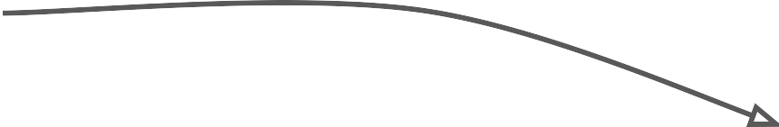
user
/
 | / | 0
2 | user | 1
3 | F1 | 2
4 | F2 | 2
5 | F3 | 2
3 | 1
3 | 2
3 | 3
3 | 1 | 1
3 | 1 | 2
3 | 1 | 3
3 | 2 | 4
3 | 2 | 5
3 | ... | ...
F1 F2 F3
$> cat /user/F1
/
user
F1
F2 F3
[{3,1},{3,2},{3,3}
],[{3,1,1},{3,1,2},
{3,1,3},{3,2,4}
…{3,3,9}]

Slide 45


Slide 46

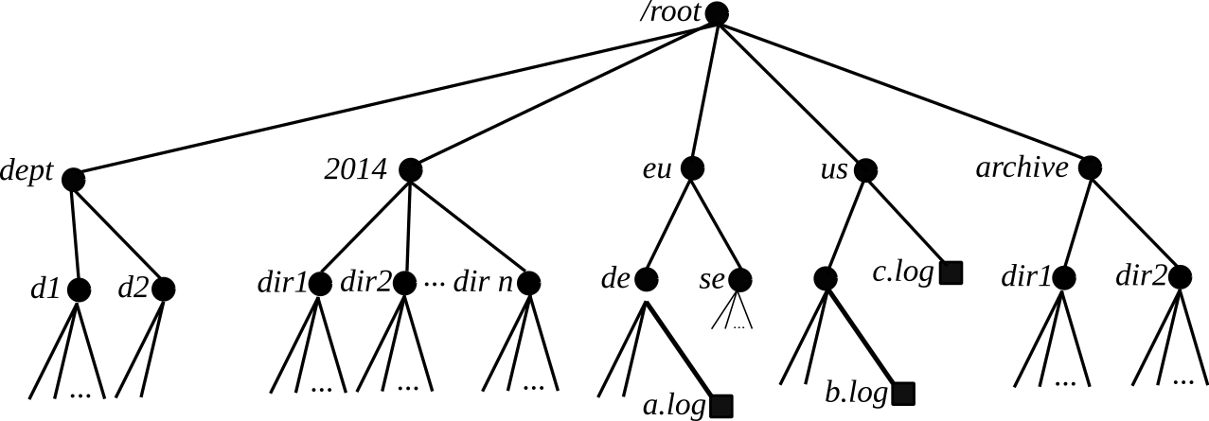

Slide 47
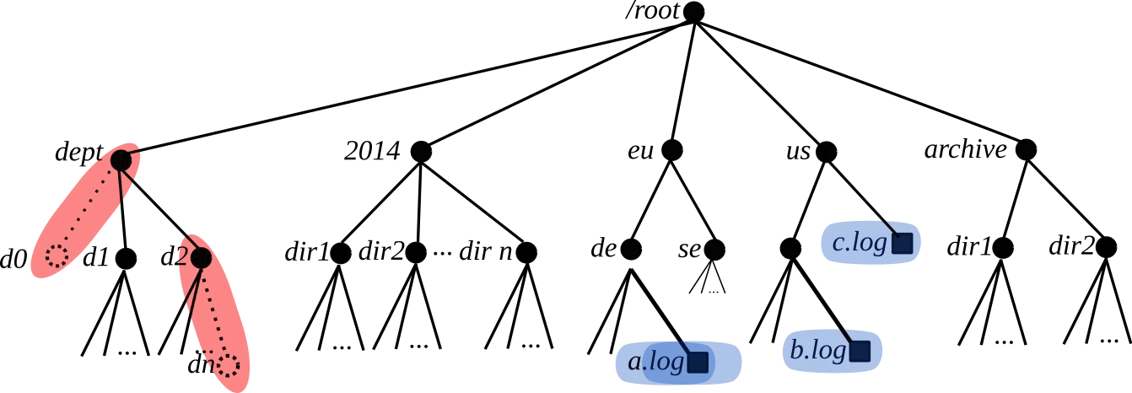
Exclusive Lock
Shared Lock

Slide 48
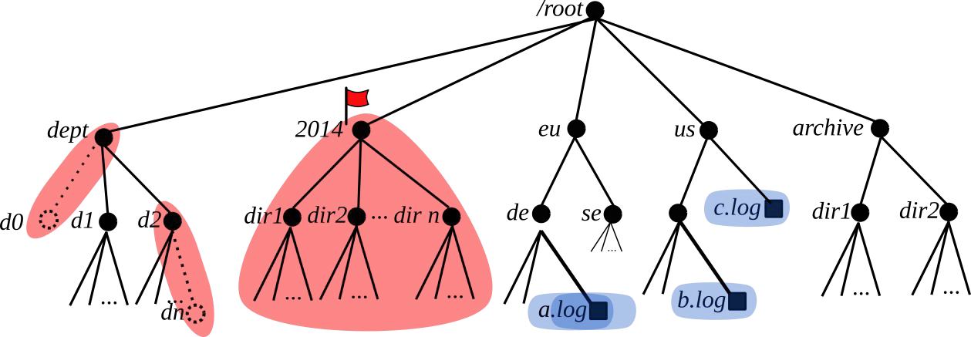
●
●
Exclusive Lock
Shared Lock Subtree Lock
48

Slide 49

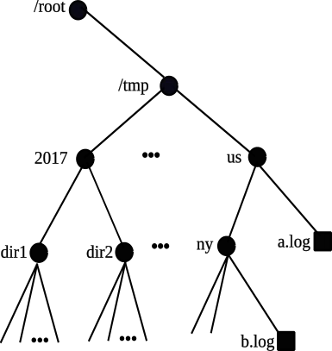
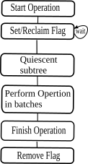
Subtree operation Stages

Slide 50
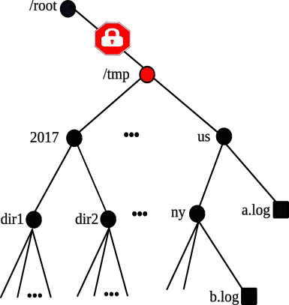
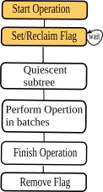
Subtree operation Stages
Subtree Locking Progresses Downwards

Slide 51
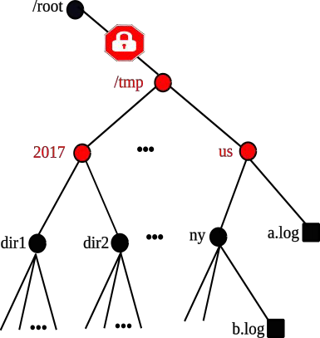
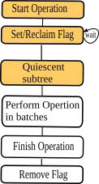
Subtree operation Stages
Subtree Locking Progresses Downwards

Slide 52
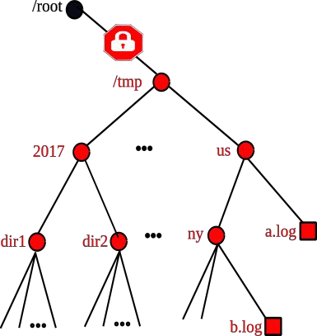
Subtree operation Stages
Subtree Locking Progresses Downwards

Slide 53
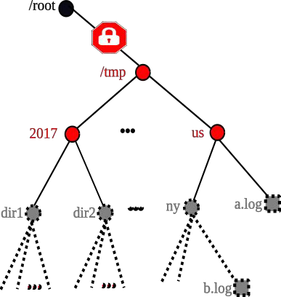
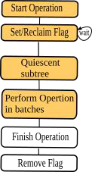
Subtree operation Stages
Delete Progresses Upwards

Slide 54
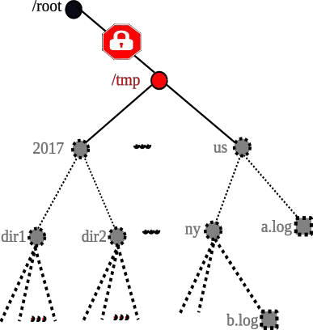
Subtree operation Stages
Delete Progresses Upwards

Slide 55
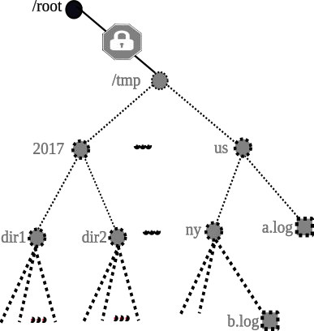
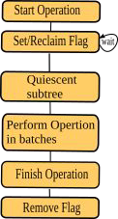
Subtree operation Stages
Delete Progresses Upwards

Slide 56
●
●

Slide 57


Slide 58



●
○
○
●
○

Slide 59
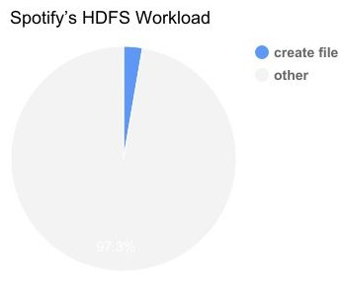
●
○
○
●
○

Slide 60
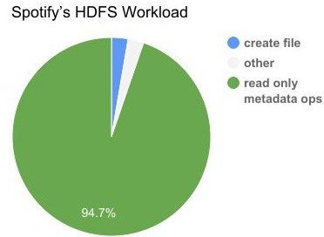
●
○
○
●
○
60

Slide 61
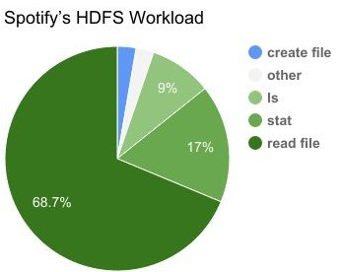
●
○
○
●
○

Slide 62
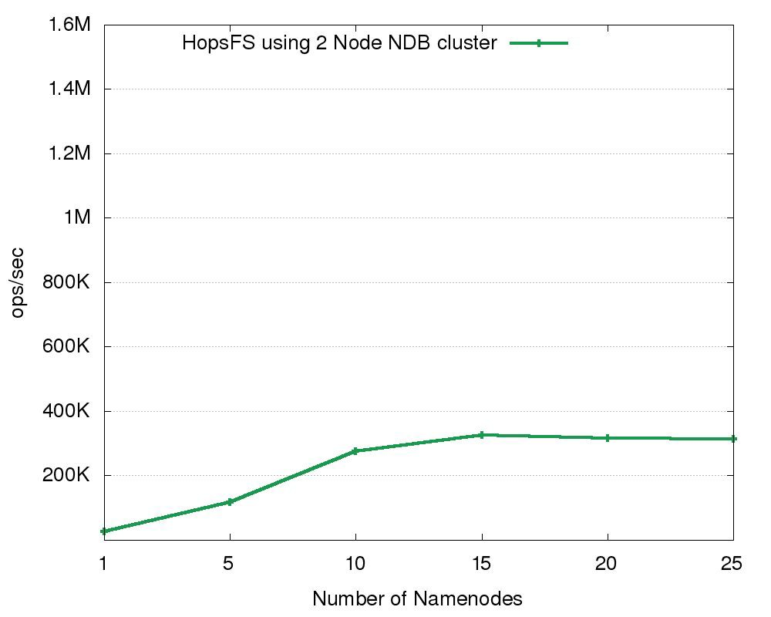

Slide 63
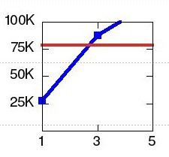
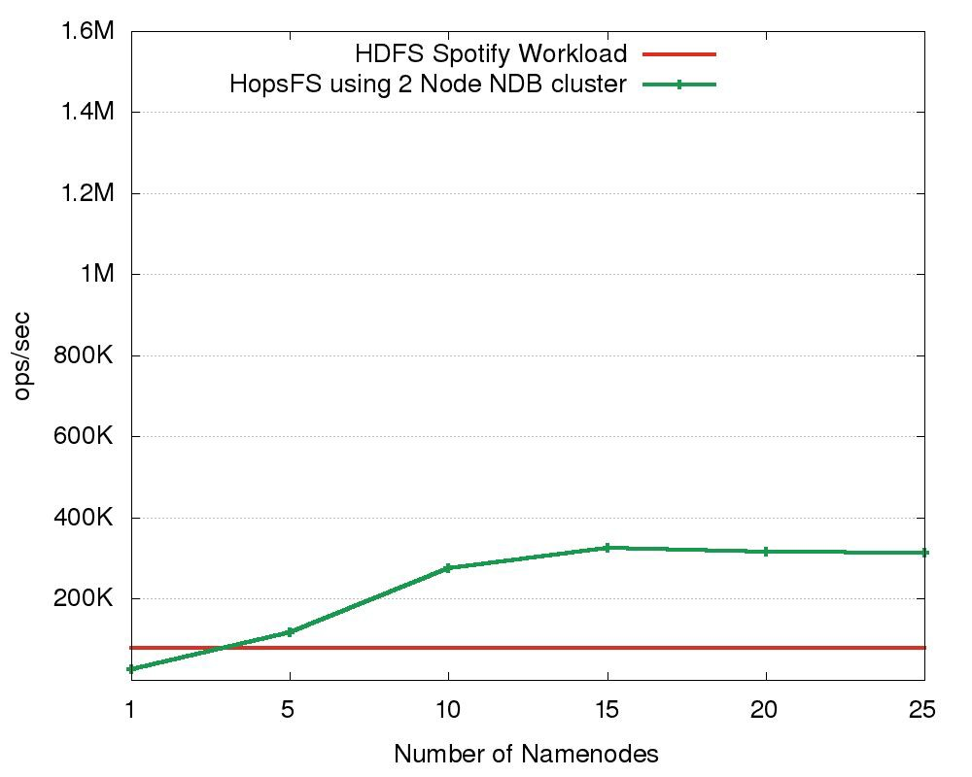

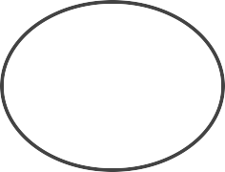
HopsFS outperforms with equivalent hardware: HA-HDFS with Five Servers
1 Active Namenode
1 Standby NameNode
3 Servers
Journal Nodes
ZooKeeper Nodes

Slide 64
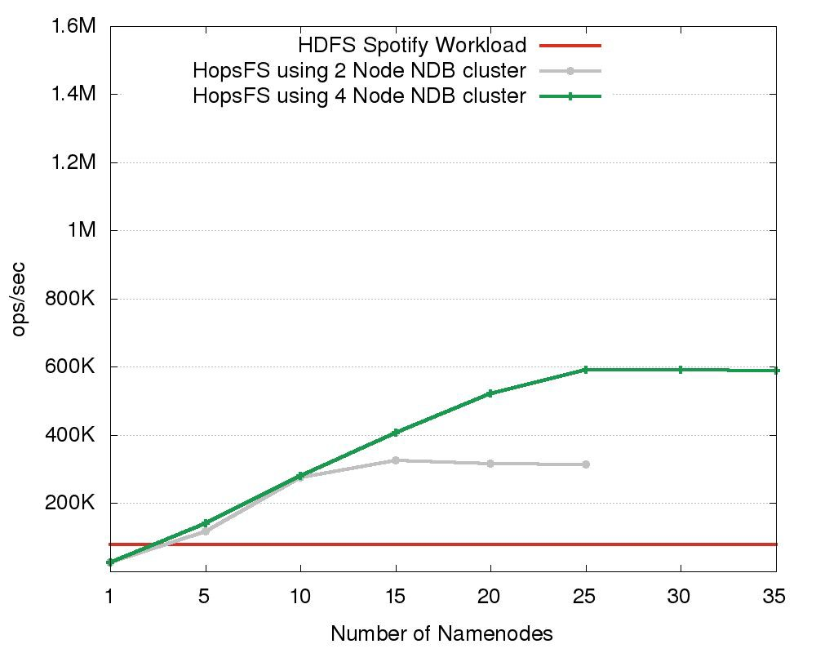

Slide 65
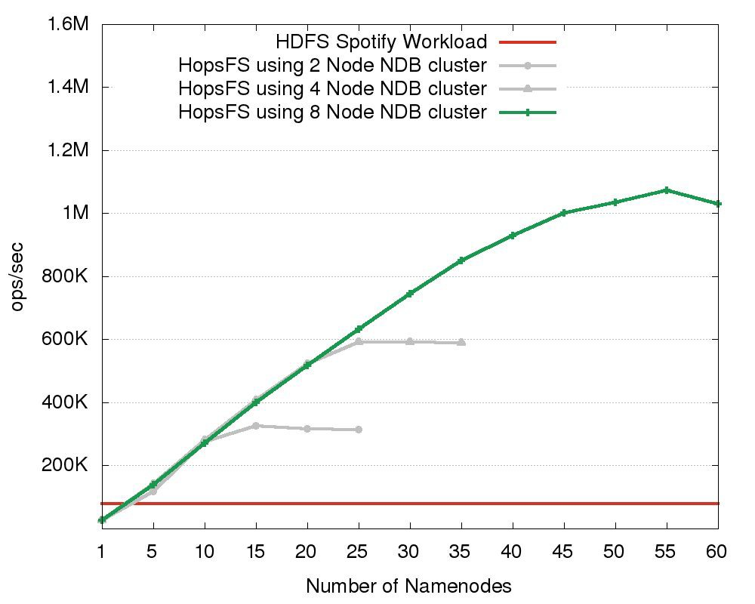

Slide 66
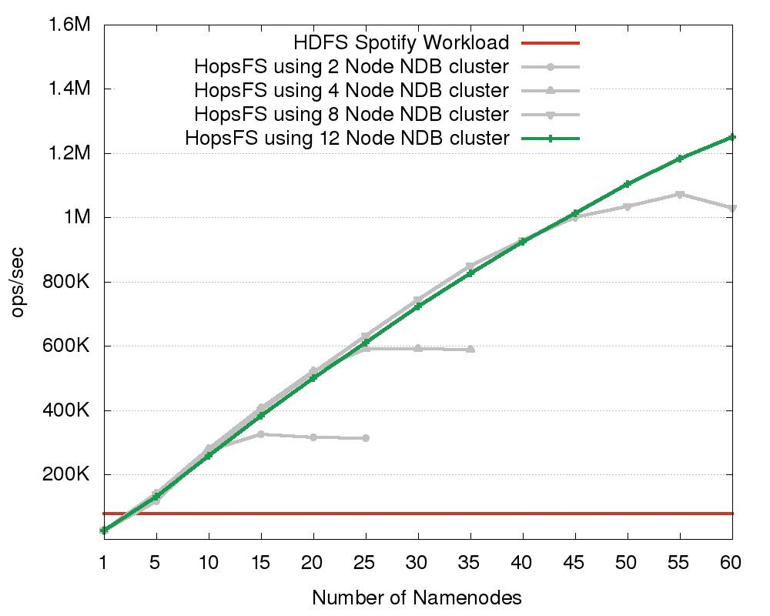

Slide 67
16X the performance of HDFS.
Further scaling possible with more hardware

Slide 68
Workloads | HopsFS ops/sec | HDFS ops/sec | Scaling Factor
Synthetic Workload (5.0% File Writes) | 1.19 M | 53.6 K | 22
Synthetic Workload (10% File Writes) | 1.04 M | 35.2 K | 30
Synthetic Workload (20% File Writes) | 0.748 M | 19.9 K | 37
Scalability of HopsFS and HDFS for write intensive workloads

Slide 69
Workloads | HopsFS ops/sec | HDFS ops/sec | Scaling Factor
Synthetic Workload (5.0% File Writes) | 1.19 M | 53.6 K | 22
Synthetic Workload (10% File Writes) | 1.04 M | 35.2 K | 30
Synthetic Workload (20% File Writes) | 0.748 M | 19.9 K | 37
Scalability of HopsFS and HDFS for write intensive workloads

Slide 70





→
70

Slide 71




→
→
➢

Slide 72

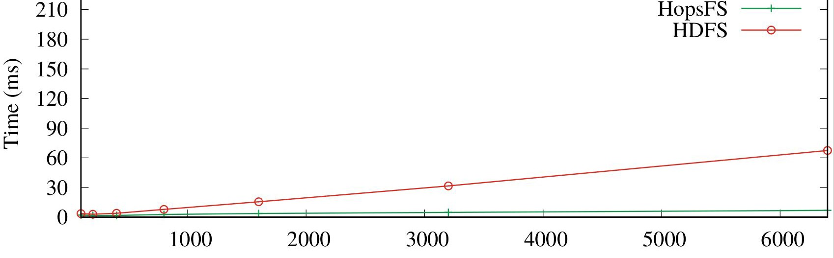
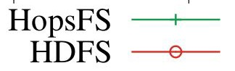
File System Clients
No of Clients | HopsFS Latency | HDFS Latency
50 | 3.0 | 3.1

Slide 73
File System Clients
No of Clients | HopsFS Latency | HDFS Latency
50 | 3.0 | 3.1
1500 | 3.7 | 15.5

Slide 74
File System Clients
No of Clients | HopsFS Latency | HDFS Latency
50 | 3.0 | 3.1
1500 | 3.7 | 15.5
6500 | 6.8 | 67.4

Slide 75
For 6500 clients HopsFS has 10 times
lower latency than HDFS
File System Clients
No of Clients | HopsFS Latency | HDFS Latency
50 | 3.0 | 3.1
1500 | 3.7 | 15.5
6500 | 6.8 | 67.4

Slide 76





Conclusion
●
●
HopsFS
HDFS

Slide 77




http://www.hops.io http://github.com/hopshadoop
@hopshadoop

